Slide 1
Library/Learning Center Resources for Faculty
Mid-Quarter Development – May 31, 2013

Slide 2
Salesforce Student Lists
Create Groups of Students
  All students in program
  Specific groups (ie. acct vs business mgmt)
  Q1 Student
Create E-Mail Templates that can be sent to specific groups.

Slide 3
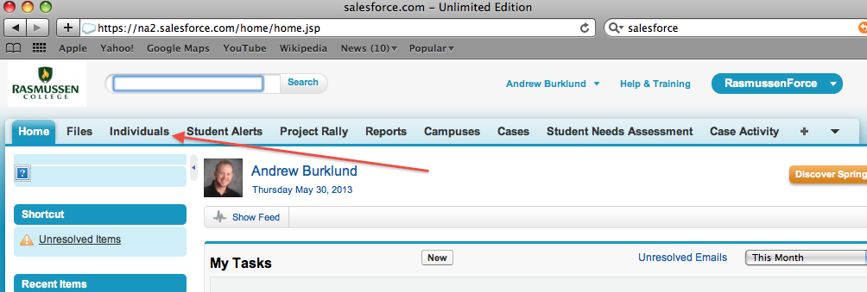
Creating Groups
Select “Individuals from the Salesforce Toolbar.

Slide 4
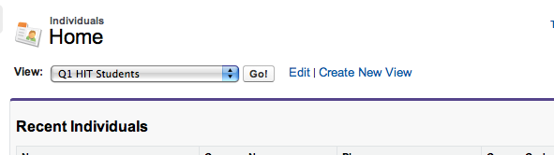
Creating Groups
The next screen is where you select each of your groups.
Click “Create New View”

Slide 5
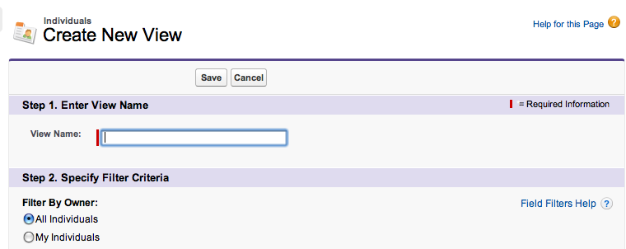
Creating Groups
Name your template
Be specific ex. “Spring 2013 Q1 Students”

Slide 6
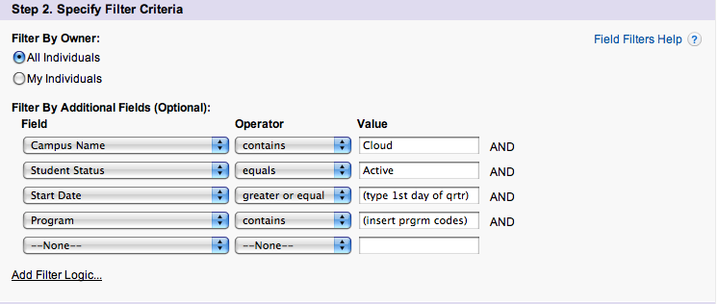
Creating Groups
The tricky part for getting your groups to create correctly involves the use of filters.

Slide 7
Creating Groups
Once you have successfully applied the filter, you will be able to save and view your grouping of students.
You will need to adjust the filter each quarter to accommodate for new students.
Consider a Q1 Full Start E-mail and a MidStart E-mail.

Slide 8
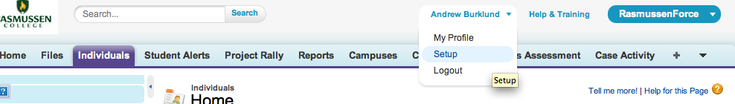
Creating Templates
Go to Setup located under the dropdown that appears under your name.

Slide 9
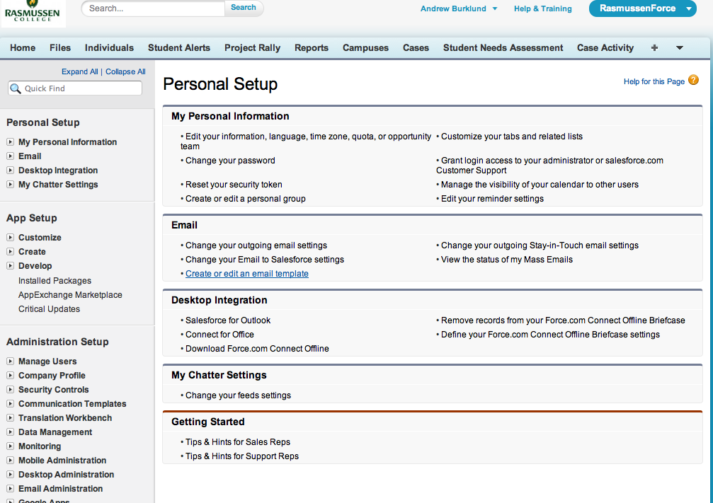
Creating Templates
You will have numerous options on this screen. Select Create or Edit an e-mail template.

Slide 10
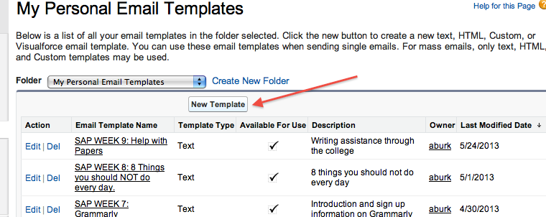
Creating Templates
You will need to click “New Template”

Slide 11
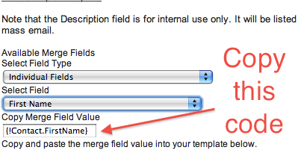
Creating New Templates
There are numerous mail merge options that can be utilized in the e-mail templates. The one you will likely only need to use is “first name”. This will pre-fill the student’s name on the e-mail you send.
Simply copy the merge code into your e-mail.

Slide 12
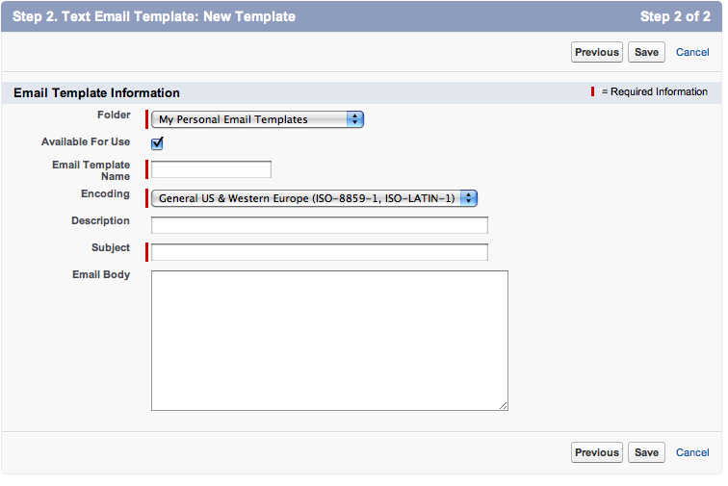
Writing Time!!
Finally, compose your e-mail.

Slide 13
Compose your first Q1 E-mail
Laurie would like you to compose your first e-mail. See the example e-mailed to you.
Templates are best when they do not include specific dates, but rather generals (ie use the last day to withdraw from a class is Friday of Week 6 vs Last day to drop is September 22nd). You can go back and edit templates but it is easier to keep them general.

Slide 14
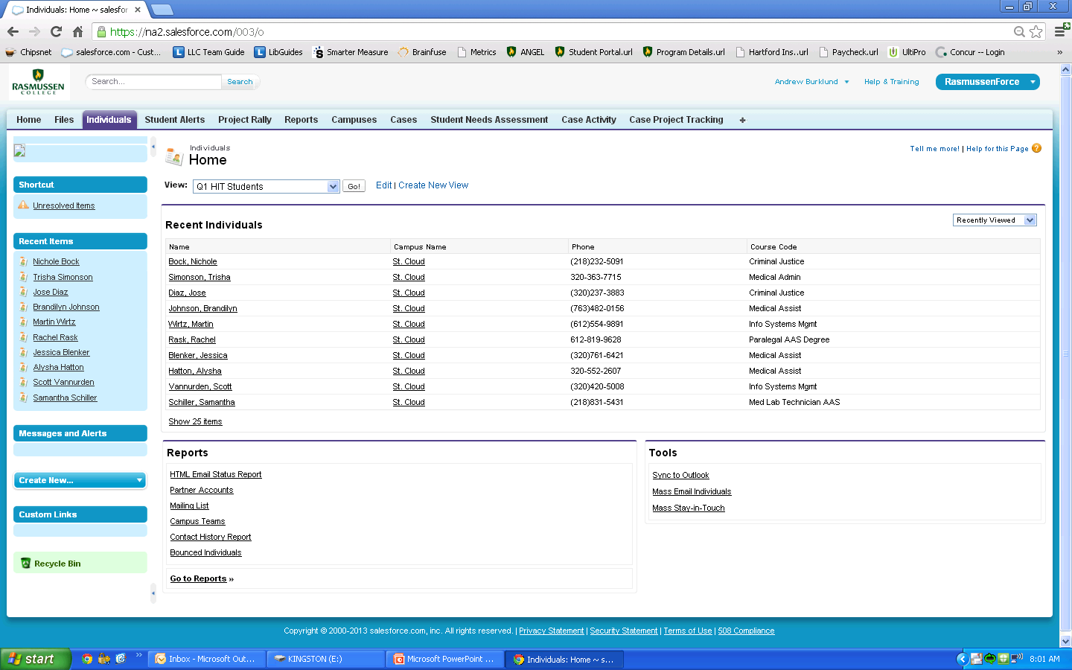
Sending a Mass E-mail
Select Individuals & then “Mass E-mail Individuals

Slide 15
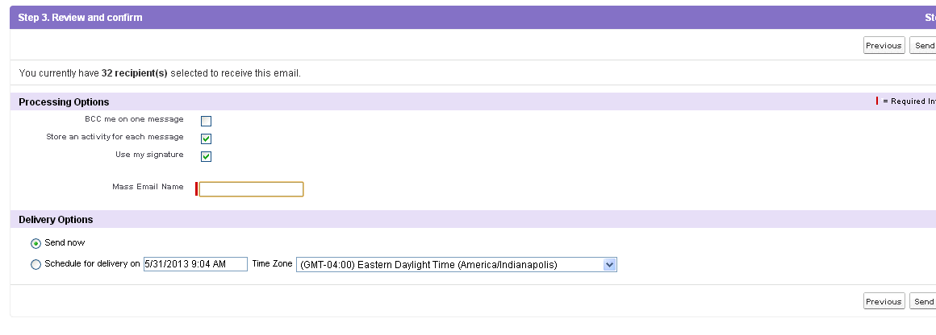
Send!
Finally, check the options and hit send.
The campus can send up to 1000 messages per day. If your message doesn’t send because of limit, set a date and time to send. (midnight of the next day)

Slide 16
Resources tab in the online classes

Slide 17

Resources screen in the online classes
Notes:
We will briefly explore the resources highlighted here. Start by demonstrating the list of databases live.

Slide 18
Databases - Comment to send to your students who are struggling with credible resources
Use the Rasmussen Library databases for your research! There are two ways to get to the Rasmussen Library databases:
1. Click on the Resources tab in your online class. Then click on
Search E-Resources
2. Login to the Student Portal, click on Library Resources on the
left, click on E-Resources
We have 79+ fabulous databases! They are in alphabetical order (except for the first one).
Start with these databases:
Discovery is the first database listed. It searches EVERYTHING Rasmussen own.
EBSCOhost MegaFILE - always a great database to start with. It searches four of our major databases.
If you are not finding what you need in the databases, use the chat box built into each database to ask questions or
contact your librarian! pat.grelson@rasmussen.edu
Notes:
Any questions about the databases? What do your students struggle with?

Slide 19
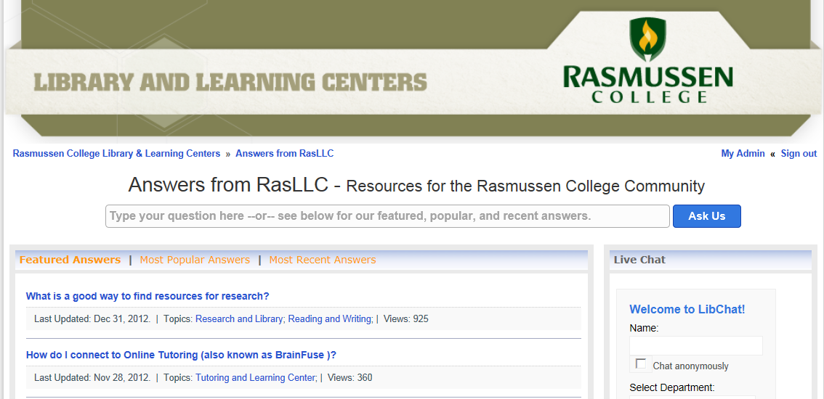
ANSWERS
Notes:
Demonstrate the live site.

Slide 20
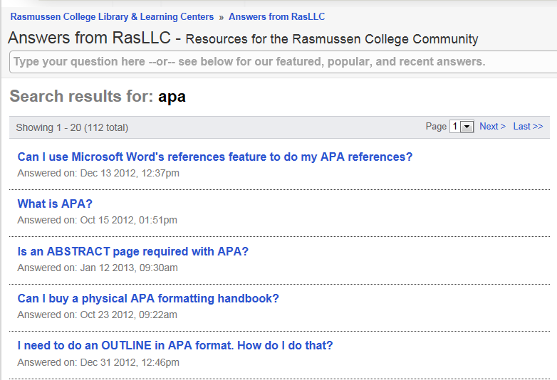
ANSWERS

Slide 21
You Try!
Go to ANSWERS
Type in in-text citations
What questions come up?
Click on them. Write down the answer you think will help your students the most.

Slide 22
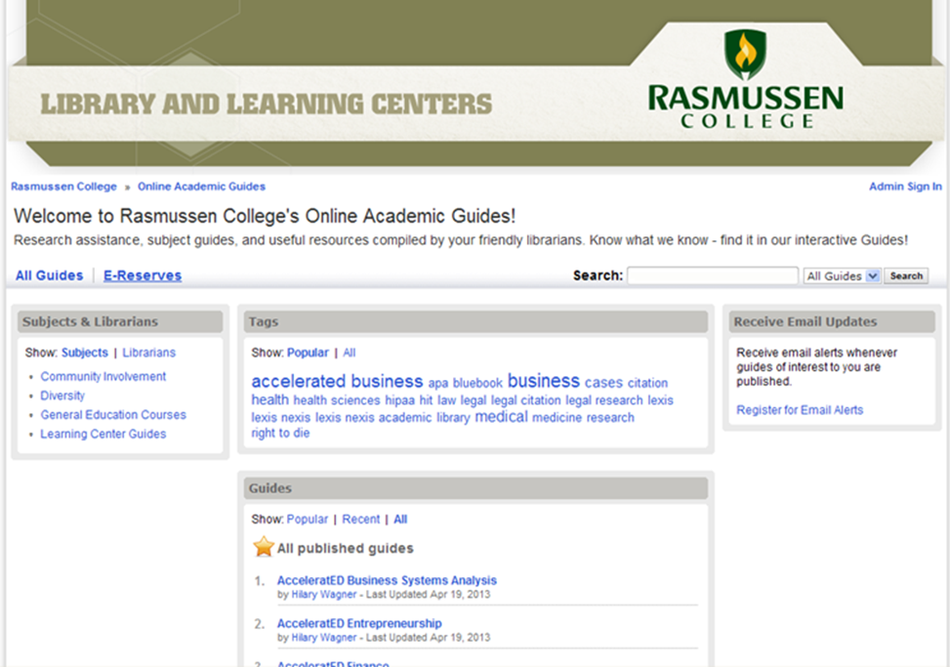
LLC Guides
At http://guides.rasmussen.edu you will find 38 helpful, informative guides.
Notes:
Demonstrate the M120 Medical Terminology guide

Slide 23
LLC Guides – You Try!
Go to http://guides.rasmussen.edu.
Scroll through the list of topics that the Library/Learning Center team has created guides for.
Find the “APA Citation Online Guide” in the list and open it.
Click on the APA Formatting tab.
Find the APA Template in Word 2010 and the video that explains how to use the template.
Go back to the list of guides and find another guide that interests you. Write the name of it here:

Slide 24
LLC Guides – Comment to send to your students who are struggling with APA issues.
This website: http://guides.rasmussen.edu/apa, it will answer most of your APA questions. There is an APA template located on this website. Click on the APA Formatting tab and then look for the APA Template in Word 2010. Right below the template is a video that shows you how to use the template. Starting your papers from this template will help to eliminate errors.
I encourage you to contact Pat the Librarian with specific APA questions: pat.grelson@rasmussen.edu

Slide 25
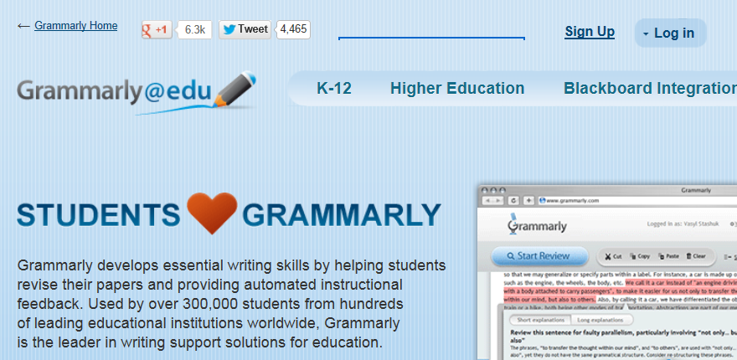
Grammarly

Slide 26
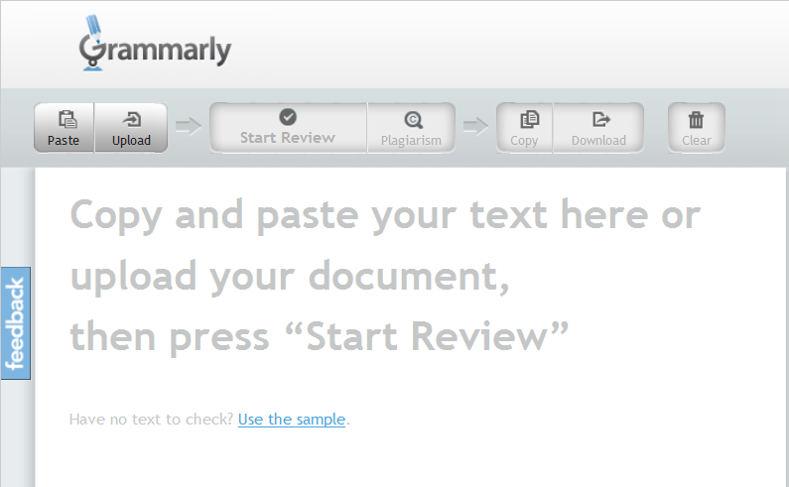
Grammarly

Slide 27
You Try!
Go to http://www.grammarly.com
Click on Sign Up
Set up your Grammarly account
    Use your Rasmussen email address
    There is NO access code, just leave it blank
Upload a paper into Grammarly
Click on the drop down menu by your name in the upper right hand corner. Click on Help. Find the article about MS Office add-in.

Slide 28
Grammarly – Comment to send to your students who are struggling with writing issues.
Grammarly is a tool that will help you edit your papers. You will find it under the Resources tab in your online class.
Please see the Grammarly handouts that I attached to my email.
You may also find this webinar on Grammarly to be helpful: https://rascolive.wimba.com/launcher.cgi?room=_00_RAS_LLC_WEB_RM_A_2013_0430_1902_03

Slide 29
Assistance from Andrew and Pat
We are here to assist you and your students!
Please feel free to send your questions and requests to us.
Please share our email addresses with your students.
Please share the names of your students with us if you would like us to contact them about the resources we have available.

